Slide 1
The Kardomah Gang

Slide 2
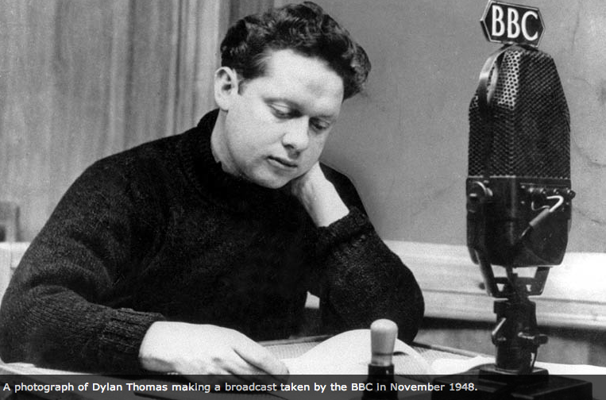
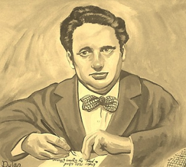
Dylan Thomas
Dylan Thomas was a poet.
He wrote about his life, friends and about Wales.
Some poems are serious, some are funny.
He was born in 1914 and his first home was in Swansea, South Wales.

Slide 3
The Kardomah Gang
Dylan Thomas was a member of the Kardomah Gang.
The Kardomah Gang were a group of friends - artists, musicians, poets and writers who used to meet in the Kardomah Café in Castle Street, Swansea in the 1930s.
There they drank coffee and discussed all sorts of subjects including religion, death, Einstein and Picasso.

Slide 4
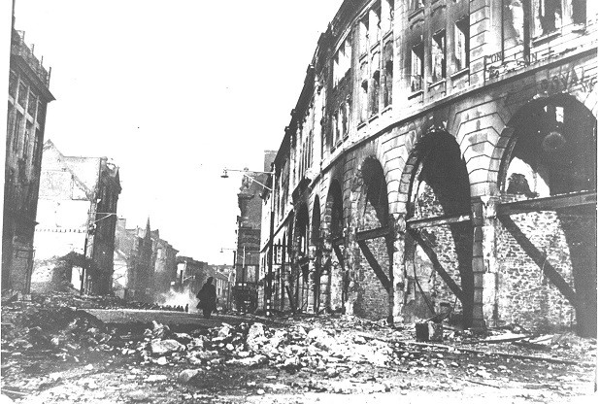
The Kardomah Gang
When Swansea was heavily bombed in February 1941, Castle Street suffered badly and the Kardomah Café was destroyed.
Dylan Thomas wrote about the
devastation in his radio play,
‘Return Journey to Swansea’ and describes
the café as being 'Razed to the snow'.
Castle street, looking North, after the Blitz
For more pictures of Swansea after the bombings click here

Slide 5
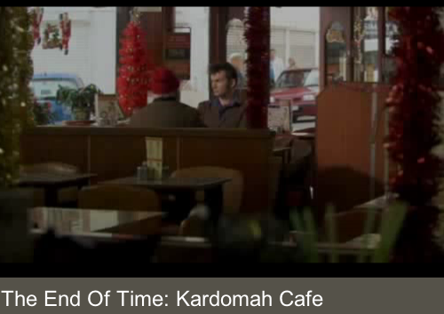
Kardomah Café
It reopened after the war in a new location in Portland Street, close to where the original cafe stood.
The café still exists today.
A scene from Doctor Who was filmed in the café in 2009 when David Tennant played the Doctor.
View the clip here

Slide 6
Kardomah Gang Activity
Which famous people would you invite to a café for a drink and a chat with you?
Choose 5 people to invite. Think about why you would choose them.
What would you talk about?

